Slide 1
React Meetup Hamburg | October 2019 | @nilshartmann
NILS HARTMANN
https://nilshartmann.net
One Year
React Hooks
A (Critical) Review
Slides: https://nils.buzz/react-meetup-hooks

Slide 2

https://nilshartmann.net
NILS HARTMANN
nils@nilshartmann.net
Developer, Architect, Trainer from Hamburg (Freelancer)
JavaScript, TypeScript
React
GraphQL
Java
Trainings, Workshops and Coachings
2nd edition out in dec!

Slide 3
React Hooks
Anyone NOT knowing what React Hooks are?

Slide 4
React Hooks
Anyone NOT knowing what React Hooks are?
(My assumption: almost noone)

Slide 5
React Hooks
Anyone NOT knowing what React Hooks are?
Hooks 2 Minute intro
add State, Lifecycle, Sideffects in functional components (almost no need for class components anylonger)

Slide 6
React Hooks
Anyone NOT knowing what React Hooks are?
Hooks 2 Minute intro
add State, Lifecycle, Sideffects in functional components (almost no need for class components anylonger)
"Hooks into your components lifecycle"

Slide 7
React Hooks
Anyone NOT knowing what React Hooks are?
Hooks 2 Minute intro
add State, Lifecycle, Sideffects in functional components (almost no need for class components anylonger)
"Hooks into your components lifecycle"
Regular JavaScript functions...
...but must start with 'use'
...but must not be used in conditionals, for/loops, Class components
...but behaviour is tied to React

Slide 8
React Hooks
Hooks example
import React, { useState } from "react";
export default function SettingsForm(props) {
const [favColor, setFavColor] = useState("blue");
return <•••>
<input value={favColor}
onChange={e => setFavColor(e.target.value) } />
<•••>
}
useState returns value and setter-function
When state changes, component re-renders
component function will run again

Slide 9
One Year
React Hooks
Notes:
Bevor wir uns mit React beschäftigen, ein kurzer Hintergrund zum Thema Single-Page-Anwendungen.

Slide 10
React Hooks
One Year of Hooks...
There are some built-in Hooks, like
useState
useReducer handle state in a Redux-like way but only for one component
useEffect for sideeffects (replaces lifecycle methods in classes)
useContext to receive a Context object
useCallback/useMemo/useRef: solve problems that arise due to using... Hooks

Slide 11
React Hooks
One Year of Hooks...
Libraries ship with Hooks, like
Redux (useSelector, useDispatch, useStore)
Router (useHistory, useParams, useLocation)
Apollo Client (useQuery, useMutation)
React Intl (useIntl)
React i18n (useTranslation)

Slide 12
React Hooks
One Year of Hooks...
Libraries ship with Hooks, like
Redux (useSelector, useDispatch, useStore)
Router (useHistory, useParams, useLocation)
Apollo Client (useQuery, useMutation)
React Intl (useIntl)
React i18n (useTranslation)
Community has them too,
https://usehooks.com
https://nikgraf.github.io/react-hooks/
https://www.hooks.guide/

Slide 13
React Hooks
One Year of Hooks...
...it seems, Hooks are the new way to go for React Apps
(Vue has them now, too btw)

Slide 14
But...
React Hooks
Good or Evil?
Notes:
Bevor wir uns mit React beschäftigen, ein kurzer Hintergrund zum Thema Single-Page-Anwendungen.

Slide 15
Good or Evil?
Who likes Hooks?

Slide 16
Good or Evil?
Who likes Hooks?
(My assumption: almost everyone)

Slide 17
Good or Evil?
Who likes Hooks?
(My assumption: almost everyone)
Who dislikes Hooks?

Slide 18
Good or Evil?
Who likes Hooks?
(My assumption: almost everyone)
Who dislikes Hooks?
(My assumption: almost noone)

Slide 19
Good or Evil?
Let's hear some more...

Slide 20
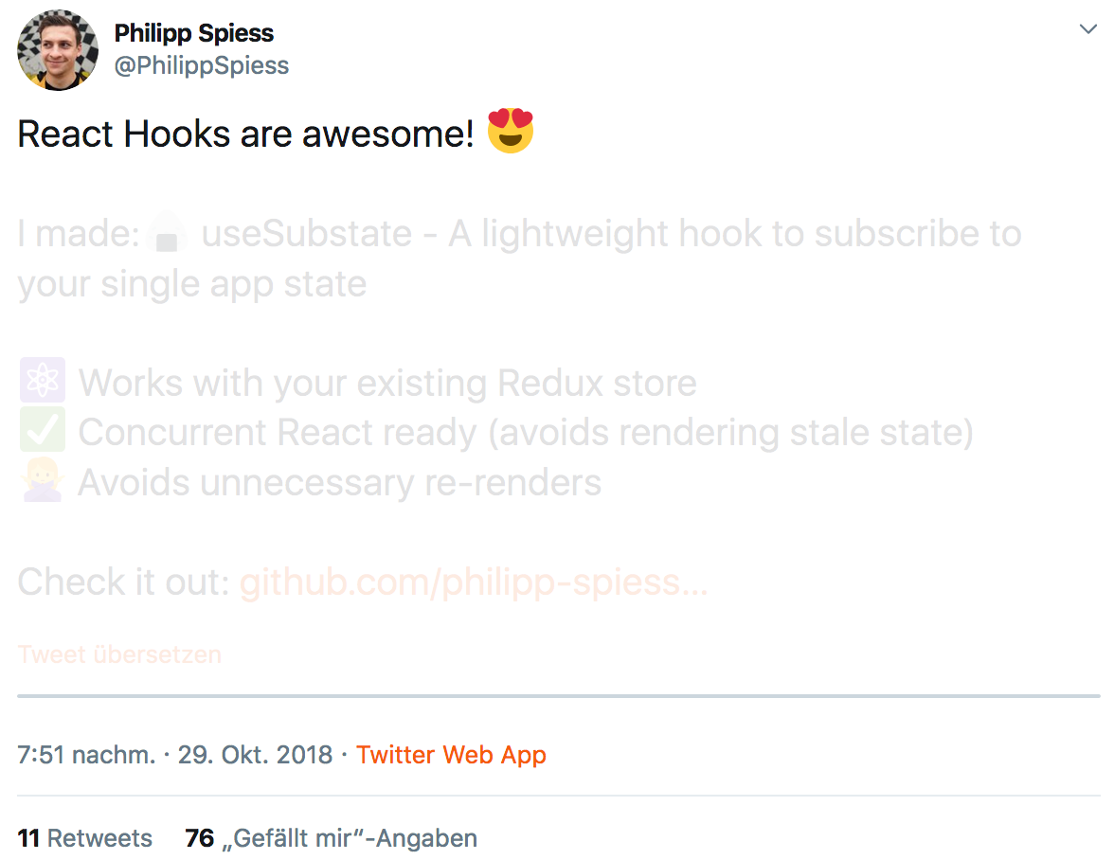
https://twitter.com/philippspiess/status/1056981916489015296
Notes:
Bevor wir uns mit React beschäftigen, ein kurzer Hintergrund zum Thema Single-Page-Anwendungen.

Slide 21
😱
"With Hooks,
React loses its innocence
and becomes Angular"
Attendee of one of my workshops
Notes:
Bevor wir uns mit React beschäftigen, ein kurzer Hintergrund zum Thema Single-Page-Anwendungen.

Slide 22

https://twitter.com/dan_abramov/status/1056808552180793344
Notes:
Bevor wir uns mit React beschäftigen, ein kurzer Hintergrund zum Thema Single-Page-Anwendungen.

Slide 23
😵
"Unsure..."
Me
Notes:
Bevor wir uns mit React beschäftigen, ein kurzer Hintergrund zum Thema Single-Page-Anwendungen.

Slide 24
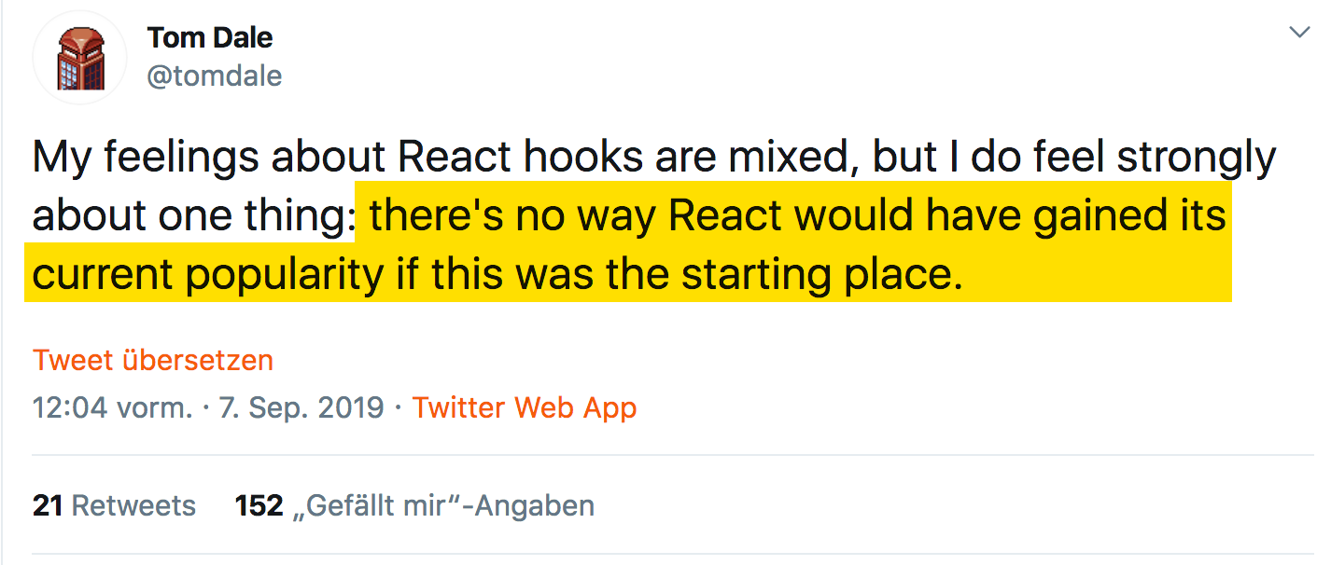
https://twitter.com/tomdale/status/1170095532066430977
Notes:
Bevor wir uns mit React beschäftigen, ein kurzer Hintergrund zum Thema Single-Page-Anwendungen.

Slide 25
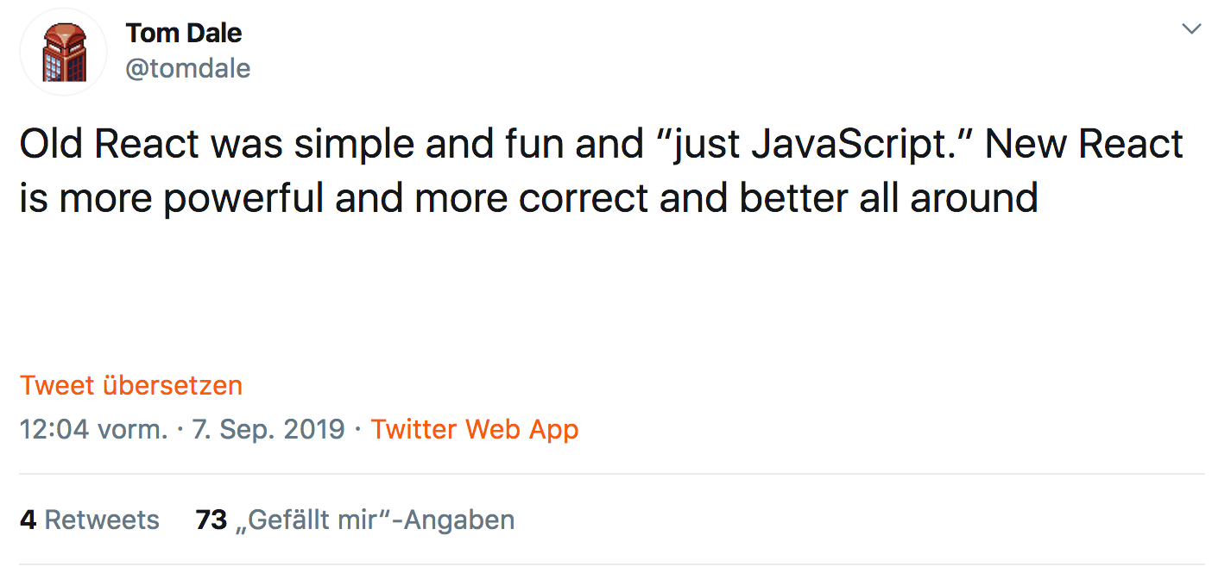
https://twitter.com/tomdale/status/1170095532922064901
Notes:
Bevor wir uns mit React beschäftigen, ein kurzer Hintergrund zum Thema Single-Page-Anwendungen.

Slide 26
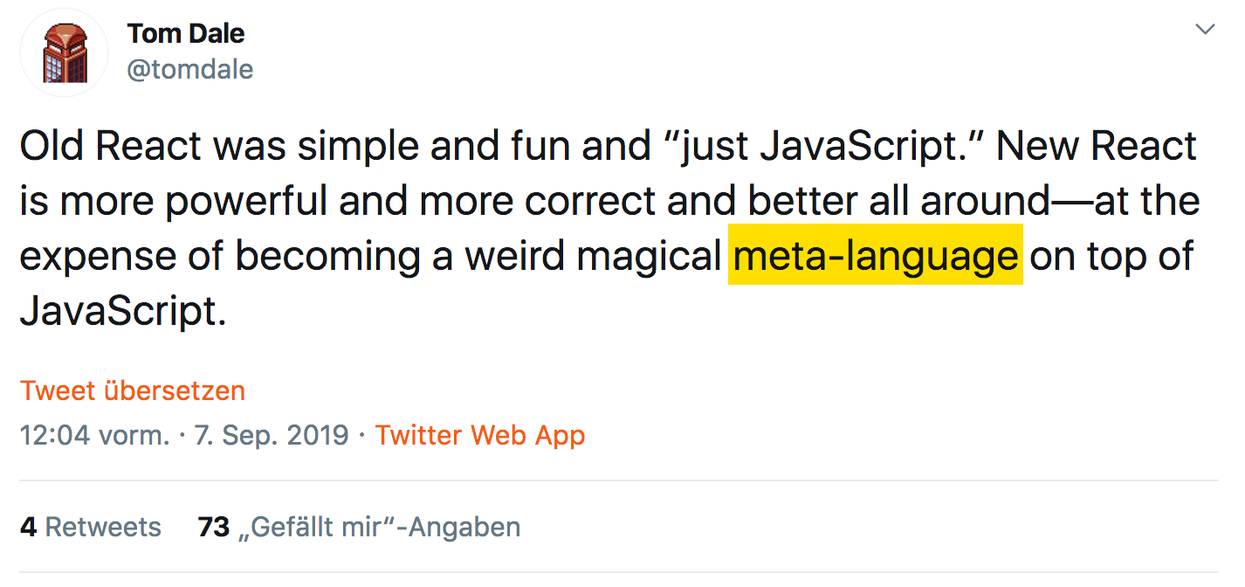
https://twitter.com/tomdale/status/1170095532922064901
Notes:
Bevor wir uns mit React beschäftigen, ein kurzer Hintergrund zum Thema Single-Page-Anwendungen.

Slide 27
why?
"awesome"
"weird"
"mixed feelings"
"angular"
Notes:
Bevor wir uns mit React beschäftigen, ein kurzer Hintergrund zum Thema Single-Page-Anwendungen.

Slide 28
React Hooks
A LOOK AT THE API
Notes:
Bevor wir uns mit React beschäftigen, ein kurzer Hintergrund zum Thema Single-Page-Anwendungen.

Slide 29
A look at the api
useContext to access React Context in your functional component
export default function SettingsForm(props) {
const contextValue = React.useContext(ThemeContext);
return <p>Your context color: {contextValue.color}</p>
}

Slide 30
A look at the api
useContext to access React Context in your functional component
export default function SettingsForm(props) {
const contextValue = React.useContext(ThemeContext);
return <p>Your context color: {contextValue.color}</p>
}
Noteable: This is probably easy to understand: I want to use context "ThemeContext" here in my component

Slide 31
A look at the api
useContext to access React Context in your functional component
export default function SettingsForm(props) {
const contextValue = React.useContext(ThemeContext);
return <p>Your context color: {contextValue.color}</p>
}
Noteable: This is probably easy to understand: I want to use context "ThemeContext" here in my component
But: if context changes, SettingsForm will automatically be re-executed! Why? Because it's a ... Hook ("weird magical meta-language") "Something" happens in the background to make that work There is no indicator that this will happen. Syntactically "only" JavaScript

Slide 32
A look at the api
useState for local State in your functional component
export default function SettingsForm(props) {
const [ favColor, setFavColor ] = useState("red");
return <input value={favColor}
onChange={e => setFavColor(e.target.value) />
}

Slide 33
A look at the api
useState for local State in your functional component
export default function SettingsForm(props) {
const [ favColor, setFavColor ] = React.seState("red");
return <input value={favColor}
onChange={e => setFavColor(e.target.value) />
}
Noteable: Return Value
what is this? Tuple! (btw: I think Tuples will make it to JavaScript)
unsual (yet), but elegant, allows to name my variables as I want them to

Slide 34
A look at the api
useState for local State in your functional component
export default function SettingsForm(props) {
const [ favColor, setFavColor ] = React.useState("red");
return <input value={favColor}
onChange={e => setFavColor(e.target.value) />
}
Noteable: Return Value
what is this? Tuple! (btw: I think Tuples will make it to JavaScript)
unsual (yet), but elegant, allows to name my variables as I want them to
Noteable: initial value, used only once even if this function is run on each render Why? Because it's a ... Hook ("weird magical meta-language")

Slide 35
A look at the api
useState for local State in your functional component
export default function SettingsForm(props) {
const [ favColor, setFavColor ] = React.useState("red");
return <input value={favColor}
onChange={e => setFavColor(e.target.value) />
}
Noteable: Return Value
what is this? Tuple! (btw: I think Tuples will make it to JavaScript)
unsual (yet), but elegant, allows to name my variables as I want them to
Noteable: initial value, used only once even if this method is run on each render Why? Because it's a ... Hook ("weird magical meta-language")
Noteable: setter-Function leads to re-render Why? Because it's a ... Hook ("weird magical meta-language")

Slide 36
A look at the api
useState another try
export default function SettingsForm(props) {
const [ easy, setEasy ] = useState(true);
function handleClick() {
setEasy(!easy);
console.log(easy);
// what is acutally easy here after first button click? 🤔
}
return <button onClick={handleClick}>Do it</button>
}
Noteable: setting a state is still "defered" or "async" Might or might not be obvious
Credits: https://twitter.com/mjackson/status/1102430168839143424

Slide 37
A look at the api
useEffect for sideeffects
export default function SettingsForm(props) {
useEffect( () => {
start();
return () => stop()
}, []
);
return <...>
}
Noteable: Everything
what is a sideeffect? API call, DOM API, console.log?
what is the return value?
what is 2nd argument ("dependency array")?
unsual way to "limit" call to functions
btw: what does [] semantically mean? Let's call the experts!

Slide 38
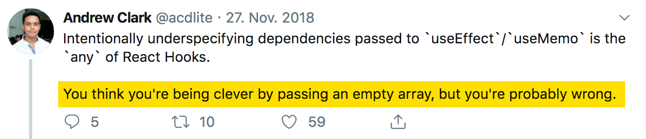
A look at the api
useEffect for sideeffects
https://twitter.com/acdlite/status/1067541310377123840

Slide 39
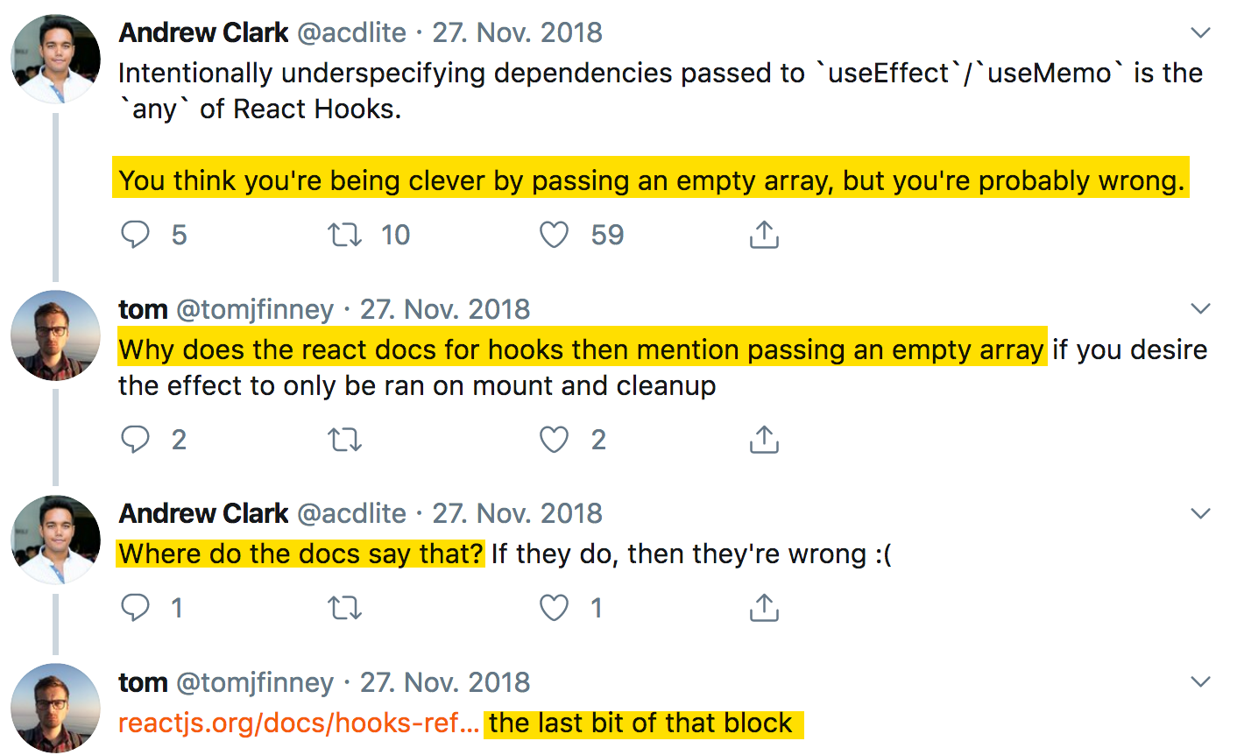
A look at the api
useEffect for sideeffects

Slide 40
A look at the api
useEffect for sideeffects

Slide 41
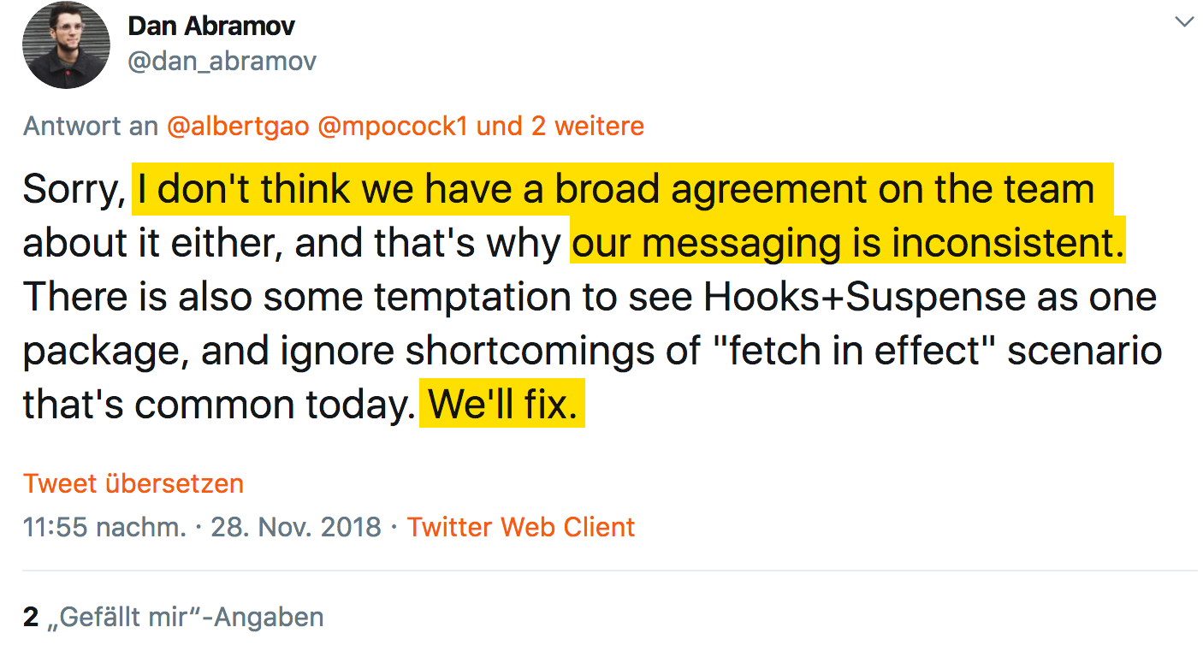
A look at the api
useEffect for sideeffects
https://twitter.com/dan_abramov/status/1067914987753091074

Slide 42
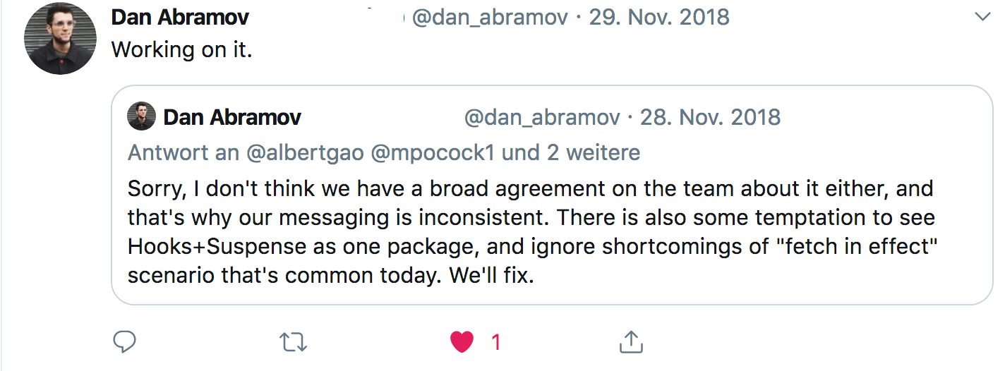
A look at the api
useEffect for sideeffects
https://twitter.com/dan_abramov/status/1067917403709943808?s=20

Slide 43
A look at the api
useEffect for sideeffects
https://twitter.com/dan_abramov/status/1067917403709943808?s=20
end of thread –

Slide 44
A look at the api
useEffect for sideeffects
https://twitter.com/dan_abramov/status/1067917403709943808?s=20
end of thread –
(to be fair: they added the [] also to the API reference now, so everything is fine now)

Slide 45
How does it Look to use Hooks?
USING HOOKS
Notes:
Bevor wir uns mit React beschäftigen, ein kurzer Hintergrund zum Thema Single-Page-Anwendungen.

Slide 46
Using hooks
Using Hooks: this is simple...
import React, { useState } from "react";
export default function SettingsForm(props) {
const [ favColor, setFavColor ] = useState("blue");
return <input value={favColor} onChange={...} />
}

Slide 47
using hooks
Using Hooks: let's add context...
import React, { useState, useContext } from "react";
export default function SettingsForm(props) {
const login = useContext(LoginContext);
const [ favColor, setFavColor ] = useState("blue");
return <input value={favColor} onChange={...} />
}

Slide 48
using hooks
Using Hooks: and now... boom!
import React, { useState, useContext } from "react";
export default function SettingsForm(props) {
const login = useContext(LoginContext);
if (!login.loggedIn) {
return <Redirect to="/login" />
}
const [ favColor, setFavColor ] = useState("blue");
return <input value={favColor} onChange={...} />
}

Slide 49
using hooks
Using Hooks: and now... boom!
import React, { useState, useContext } from "react";
export default function SettingsForm(props) {
const login = useContext(LoginContext);
if (!login.loggedIn) {
return <Redirect to="/login" />
}
const [ favColor, setFavColor ] = useState("blue");
return <input value={favColor} onChange={...} />
}
😱
Why? Because it's a ... Hook ("weird magical meta-language") Hooks must always be called in the same order

Slide 50
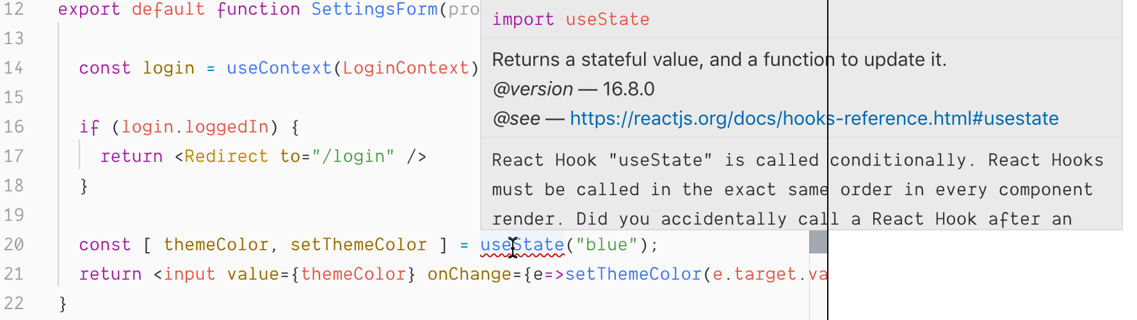
using hooks
Linter: saves us!
to be fair: eslint-plugin-react-hooks is really good and helpful

Slide 51
using hooks
...and another one: useHistory from React Router
import { useHistory } from "react-router-dom";
export default function SettingsForm(props) {
function saveAndRedirect() {
saveSettings().then(
() => useHistory().push("/home")
);
}
return <•••><button onClick={saveAndRedirect}>Save</button><•••>
}
"weird magical meta-language"
😱

Slide 52
using hooks
...this works
import { useHistory } from "react-router-dom";
export default function SettingsForm(props) {
const history = useHistory();
function saveAndRedirect() {
saveSettings().then(
() => history.push("/home")
);
}
return <•••><button onClick={saveAndRedirect}>Save</button><•••>
}
Might not be big difference, but...
☺️

Slide 53
using hooks
Might not be a big difference, but...
you have to know where you can use Hooks
forces you to structure your code in exactly this way
it's not "standard javascript"

Slide 54
using hooks
Might not be a big difference, but...
you have to know where you can use Hooks
forces you to structure your code in exactly this way
it's not "standard javascript"
Do you remember why React doesn't add a template language?

Slide 55
using hooks
Might not be a big difference, but...
you have to know where you can use Hooks
forces you to structure your code in exactly this way
it's not "standard javascript"
Do you remember why React doesn't add a template language?
To enable us to use our "favorite" language: JavaScript
no need to learn a new language...

Slide 56
using hooks
Might not be a big difference, but...
you have to know where you can use Hooks
forces you to structure your code in exactly this way
it's not "standard javascript"
Do you remember why React doesn't add a template language?
To enable us to use our "favorite" language: JavaScript
no need to learn a new language...
Does that mean Hooks (or React) are evil?
No, but... they have their "price" (as classes have)
It's "rethinking" again

Slide 57
of using Hooks
Consequences
Notes:
Bevor wir uns mit React beschäftigen, ein kurzer Hintergrund zum Thema Single-Page-Anwendungen.

Slide 58
Consequences
Can Custom Hooks replace existing patterns?
Custom Hooks are another way for reusable logic
Replacement for HOCs?
Replacement for Render Properties?
Would be good imho
esp. HOCs hard to understand
But...

Slide 59
Consequences
Example: React Router withRouter HOC
import { withRouter } from "react-router-dom";
function SettingsForm( { history } ) {
function saveAndRedirect() {
saveSettings().then( () => history.push("/home") );
}
return <•••><button onClick={saveAndRedirect}>Save</button><•••>
}
export default withRouter(SettingsForm);

Slide 60
A look at the api
Example: React Router useHistory Custom Hook
import { useHistory } from "react-router-dom";
export default function SettingsForm( props ) {
const history = useHistory();
function saveAndRedirect() {
saveSettings().then( () => history.push("/home") );
}
return <•••><button onClick={saveAndRedirect}>Save</button><•••>
}
Difference:
Only one component (vs SettingsForm and HOC'd SettingsForm)
SettingsForm "knows" about Router, it's not "just a prop" anymore

Slide 61
A look at the api
Another one: React Router (with render prop)
// App.js
<Route path="/settings/:id"
render={({match}) => <SettingsForm settingsId={match.params.id} />
// SettingsForm.js
export default function SettingsForm( {settingsId} ) {
// do something with settingsId
return •••;
}
Noteable:
SettingsForm does not know anything about Router
Routing "Logic" (Params, Routes, ...) are at one place (good imho)

Slide 62
A look at the api
Example: React Router with new Route API and useParams
// App.js
<Route path="/settings/:id"><SettingsForm /></Route>
new Router
5.2 API
no render prop anymore!

Slide 63
A look at the api
Another one: React Router with new Route API and useParams
// App.js
<Route path="/settings/:id"><SettingsForm /></Route>
// SettingsForm.js
import { useParams } from "react-router-dom";
export default function SettingsForm( ) {
const { settingsId } = useParams();
// do something with settingsId
return •••;
}
Noteable:
SettingsForm knows about Router API and Routing "Logic" (which Params)
What about "Colocation"?
new Router
5.2 API
no render-Prop anymore
(credits: https://twitter.com/andrewgreenh/status/1177213442710745091?s=20)

Slide 64
A look at the api
What about this one? (from: https://twitter.com/Wolverineks/status/1177818104048472065)
function RouterContext({ children }) {
return children({
history: useHistory(),
params: useParams(),
...
});
}

Slide 65
A look at the api
What about this one? (from: https://twitter.com/Wolverineks/status/1177818104048472065)
function RouterContext({ children }) {
return children({
history: useHistory(),
params: useParams(),
...
});
}
<Route path="/settings/:id">
<RouterContext>
{({ params }) => <SettingsForm settingsId={params.id} />
</RouterContext>
</Router>

Slide 66

A look at the api
What about this one? (from: https://twitter.com/Wolverineks/status/1177818104048472065)
function RouterContext({ children }) {
return children({
history: useHistory(),
params: useParams(),
...
});
}
<Route path="/settings/:id">
<RouterContext>
{({ params }) => <SettingsForm settingsId={params.id} />
</RouterContext>
</Router>
Noteable: welcome back, render properties!
But at least SettingsForm is Router-free

Slide 67
Consequences
What does that mean?
Hooks provide new ways for structuring code, architecture etc
But they come with a price
nothing comes for free, nothing special here
We probably we will see new patterns, best-practices evolving
Still no "React Best Practices"

Slide 68
A look at the api
Example: Redux useDispatch and useSelector instead of connect
import { useDispatch, useSelector } from "react-redux";
export default function SettingsForm(props) {
const favColor = useSelector(state => state.theme.favColor);
const dispatch = useDispatch();
const setNewColor = (r,g,b) => dispatch(actions.setNewColor(r,g,b));
return <•••><ColorPicker onSet={setNewColor}/><•••>
}

Slide 69
A look at the api
Example: Redux useDispatch and useSelector instead of connect
import { useDispatch, useSelector } from "react-redux";
export default function SettingsForm(props) {
const favColor = useSelector(state => state.theme.favColor);
const dispatch = useDispatch();
const setNewColor = (r,g,b) => dispatch(actions.setNewColor(r,g,b));
return <•••><ColorPicker onSet={setNewColor}/><•••>
}
Consequences:
We now have only one component, have seen that already
the component is bound to Redux, have seen that already

Slide 70
A look at the api
Example: Redux useDispatch and useSelector instead of connect
import { useDispatch, useSelector } from "react-redux";
export default function SettingsForm(props) {
const favColor = useSelector(state => state.theme.favColor);
const dispatch = useDispatch();
const setNewColor = (r,g,b) => dispatch(actions.setNewColor(r,g,b));
return <•••><ColorPicker onSet={setNewColor}/><•••>
}
Consequences:
We now have only one component, have seen that already
the component is bound to Redux, have seen that already
But: it also has different rendering behaviour (compared to connect)
might "force" re-rendering of the ColorPicker component

Slide 71
A look at the api
We can fix this:
import { useDispatch, useSelector } from "react-redux";
export default function SettingsForm(props) {
const favColor = useSelector(state => state.theme.favColor);
const dispatch = useDispatch();
const setNewColor = React.useCallback(
(r,g,b) => dispatch(actions.setNewColor(r,g,b)),
[ dispatch ]
);
return <•••><ColorPicker onSet={setNewColor}/><•••>
}

Slide 72
A look at the api
We can fix this:
import { useDispatch, useSelector } from "react-redux";
export default function SettingsForm(props) {
const favColor = useSelector(state => state.theme.favColor);
const dispatch = useDispatch();
const setNewColor = React.useCallback(
(r,g,b) => dispatch(actions.setNewColor(r,g,b)),
[ dispatch ]
);
return <•••><ColorPicker onSet={setNewColor}/><•••>
}
"Nice!" (Fortunately we only have one callback function here...)
remember the dependency array? 👋

Slide 73
A look at the api
Again: is this really a problem?
This problem is not related to Redux only
In most cases not as performance might be good enough to re-render all the time, so useCallback (and useMemo) is not a must
But this is – esp. for Beginners – not easy to understand (call me a Beginner)
BTW: I wonder how many CPU engery is wasted due to billions of unneccessary function executions in React Apps world wide 🤓

Slide 74
Consequences
Let's have a look at the component lifecycle
Want to start and stop a timeout (automatically after render)
export default function App() {
const [running, setRunning] = useState(false);
useEffect(() => {
const id = setTimeout(() => {
setRunning(false);
}, 2000);
setRunning(true);
return () => clearTimeout(id);
}, []);
return <>Running: {running.toString()}</>;
}

Slide 75
Consequences
Let's have a look at the component lifecycle
Want to start and stop a timeout (automatically after render)
export default function App() {
const [running, setRunning] = useState(false);
useEffect(() => {
const id = setTimeout(() => {
console.log(running);
setRunning(false);
}, 2000);
setRunning(true);
return () => clearTimeout(id);
}, []);
return <>Running: {running.toString()}</>;
}
1. what will be dumped to console?

Slide 76
Consequences
Let's have a look at the component lifecycle
Want to start and stop a timeout (automatically after render)
export default function App() {
const [running, setRunning] = useState(false);
useEffect(() => {
const id = setTimeout(() => {
console.log(running);
setRunning(false);
}, 2000);
setRunning(true);
return () => clearTimeout(id);
}, []);
return <>Running: {running.toString()}</>;
}
1. what will be dumped to console?
2. what will the linter say?

Slide 77
Consequences
Let's have a look at the component lifecycle
Want to start and stop a timeout (automatically after render)
export default function App() {
const [running, setRunning] = useState(false);
useEffect(() => {
const id = setTimeout(() => {
console.log(running);
setRunning(false);
}, 2000);
setRunning(true);
return () => clearTimeout(id);
}, [running]);
return <>Running: {running.toString()}</>;
}
1. what will be dumped to console?
2. what will the linter say?
3. what happens if we add 'running'?

Slide 78
Consequences
Let's have a look at the component lifecycle
This behaviour makes totally sense
Hard to get maybe, but hard due to the nature of the problem
async code
values/behaviour dependending on each other
Is declarative programming style apropriate here?

Slide 79
Consequences
Let's have a look at the component lifecycle
We want to cancel the running timeout
Somehow need to get access to the cleanup function or the id
export default function App() {
const [running, setRunning] = useState(false);
function cancel() { 🤔 }
useEffect(() => {
const id = setTimeout(() => setRunning(false), 2000);
setRunning(true);
return () => clearTimeout(id);
}, []);
return <button onClick={cancel}>Running: {running.toString()}</button>;
}

Slide 80
Consequences
Let's have a look at the component lifecycle
We want to cancel the running timeout
Somehow need to get access to the cleanup function or the id
export default function App() {
const [running, setRunning] = useState(false);
const timerRef = useRef();
function cancel() { clearTimeout(timerRef.current); }
useEffect(() => {
const id = setTimeout(() => setRunning(false), 2000);
timerRef.current = id;
setRunning(true);
return () => clearTimeout(id);
}, []);
return <button onClick={cancel}>Running: {running.toString()}</button>;
}

Slide 81
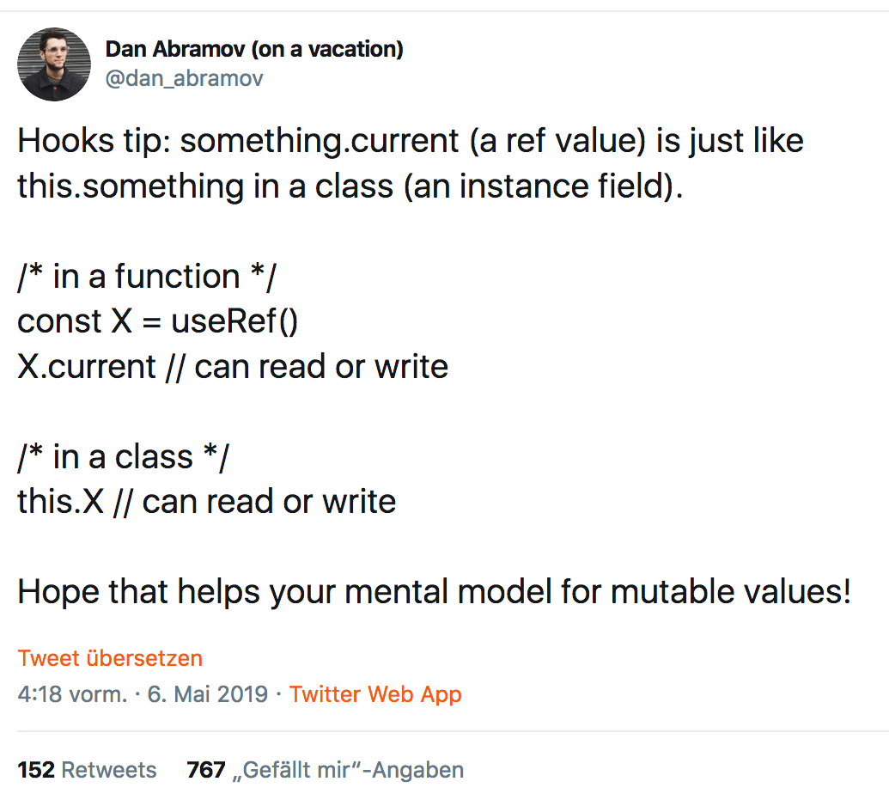
Consequences
useRef
"weird magical meta-language"
JavaScript Standard
https://twitter.com/dan_abramov/status/1125223181701263360

Slide 82
Consequences
A look back to...
export default class App extends React.Component {
state = { running: false }
componentDidMount() {
this.timeoutId = setTimeout(() => {
console.log(this.state.running);
this.setState({running:false)};
), 2000);
this.setState({running: true});
}
componentWillUnmount() {
clearTimeout(this.timeoutId);
render() {
return <button onClick={() =>
clearInterval(this.timeoutId)}>...</button>
}
}

Slide 83
Consequences
A look back to...
export default class App extends React.Component {
state = { running: false }
componentDidMount() {
this.timeoutId = setTimeout(() => {
console.log(this.state.running);
this.setState({running:false)};
), 2000);
this.setState({running: true});
}
componentWillUnmount() {
clearTimeout(this.timeoutId);
render() {
return <button onClick={() =>
clearInterval(this.timeoutId)}>...</button>
}
}
Clear lifecycle

Slide 84
with Hooks
TypeScript
Notes:
Bevor wir uns mit React beschäftigen, ein kurzer Hintergrund zum Thema Single-Page-Anwendungen.

Slide 85
TypeScript
Type Inference with useState works very good!
export default function SettingsForm(props) {
const favColor = useState("");
// typeof favColor === string
return •••;
}

Slide 86
TypeScript
...custom hook for typing useSelector?
function useAppSelector<R>(fn: (state: AppState) => R): R {
return useSelector(fn)
}
export default function SettingsForm(props) {
const favColor = useAppSelector(state => state.favColor);
return •••;
}

Slide 87
One Year React Hooks
Summary
If you're already using React, use Hooks.
They will stay. It's the "New React". Classes will lose their relevance.
For (experienced) React developers they are a good innovation
We will see how Hooks-based architectures evolve

Slide 88
One Year React Hooks
Summary
If you're already using React, use Hooks.
They will stay. It's the "New React". Classes will lose their relevance.
For (experienced) React developers they are a good innovation
We will see how Hooks-based architectures evolve
However:
While technically standard JavaScript functions, their usage is not
They are more like an own "magical meta-language" for React
Selling point "you only have to know JavaScript to learn React" is not valid anymore (if it has ever been)

Slide 89
One Year React Hooks
Summary
If you're already using React, use Hooks.
They will stay. It's the "New React". Classes will lose their relevance.
For (experienced) React developers they are a good innovation
We will see how Hooks-based architectures evolve
However:
While technically standard JavaScript functions, their usage is not
They are more like an own "magical meta-language" for React
Selling point "you only have to know JavaScript to learn React" is not valid anymore (if it has ever been)
For people not familiar with React/new to React
Hooks might scare people
As React becomes a little less "JS Standard", People might consider alternatives, like Web Components (Standard!)
We're still far away from "React Best Practices"

Slide 90
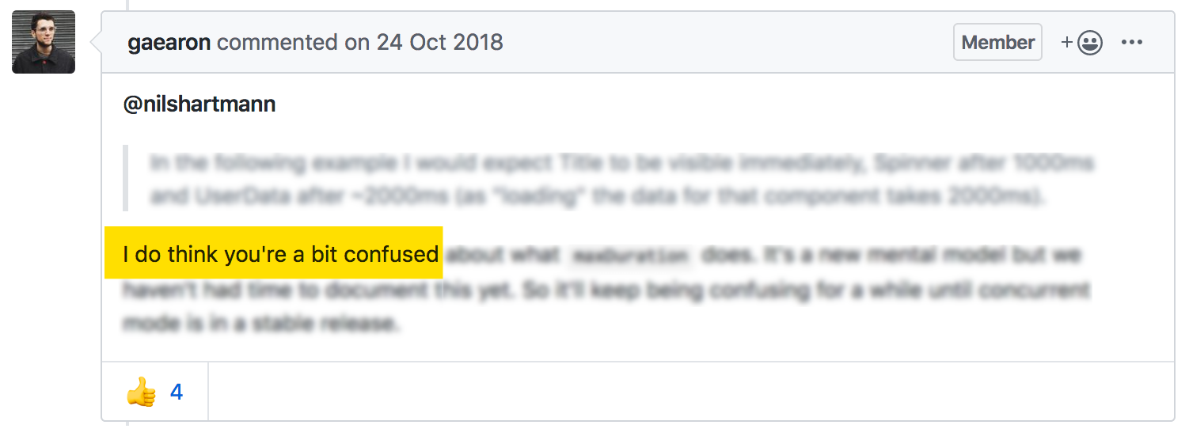
Note!
Disclaimer on all what I told you today
https://github.com/facebook/react/issues/13206#issuecomment-432489986

Slide 91
nils@nilshartmann.net
NILS HARTMANN
https://nilshartmann.net
🌻
Thanks a lot!
What do you think?
Slides: https://nils.buzz/react-meetup-hooks

